Slide 1
An Automatic Segmentation Technique for Detection of Road Safety Attributes using Video Data
Thihagoda Gamage Pubudu Sanjeewani
PhD Candidate, ARC Linkage Project Scholarship

Slide 2
Introduction
Increasing road traffic accidents.
Manual road safety systems in operation today are inefficient, prone to many faults, and expensive.
Existing systems unable to accurately extract roadside objects essential for road safety.
The aim of my research is to develop an automatic technique for segmentation and classification of Australian Road Assessment Program (AusRAP) attributes from digital video recording and measure accurate distance between these attributes.

Slide 3
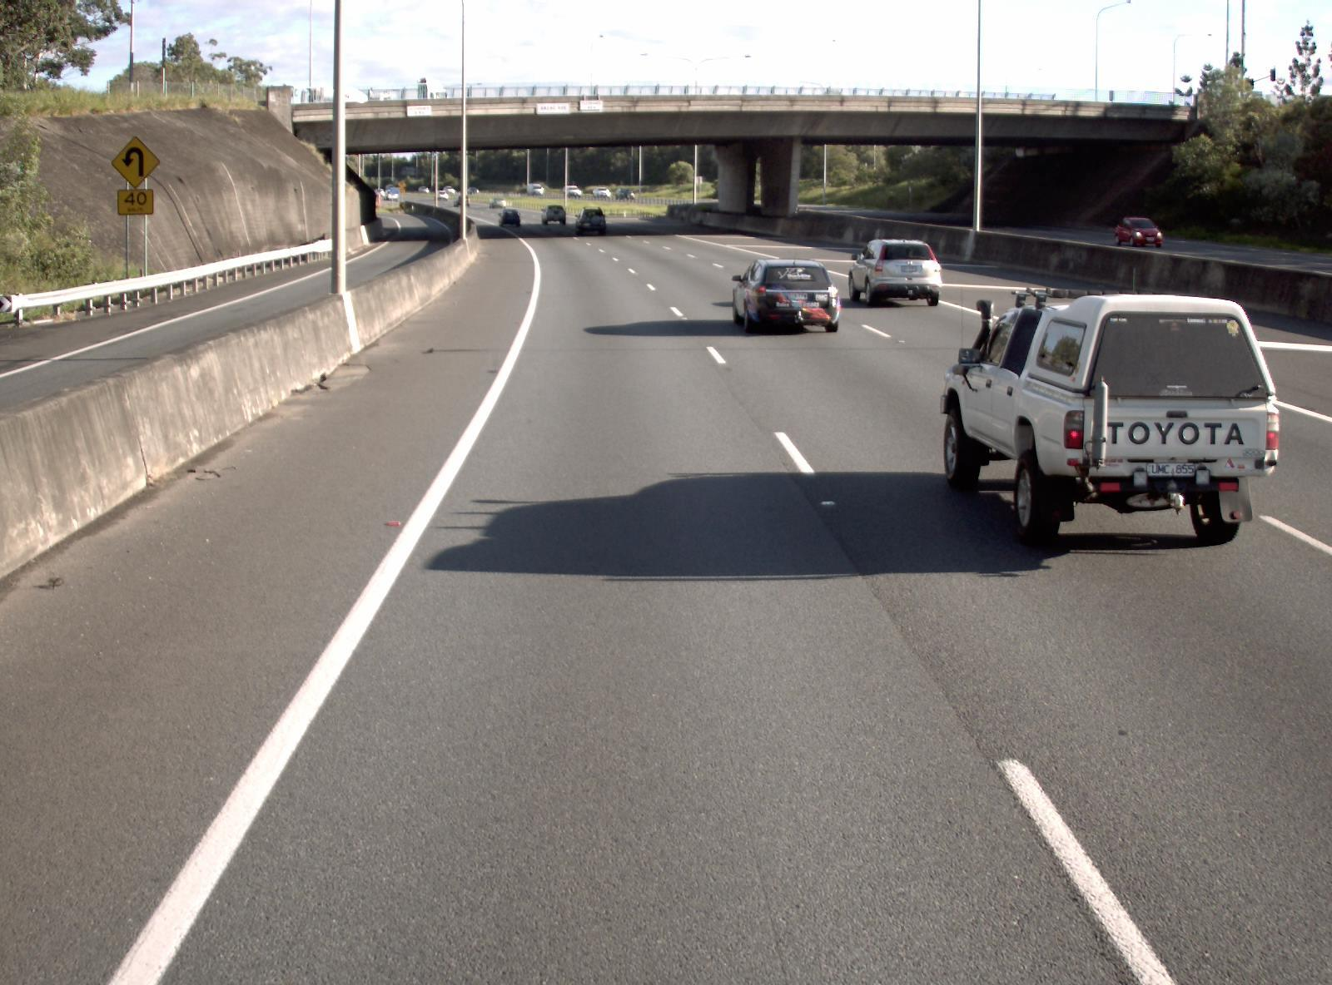
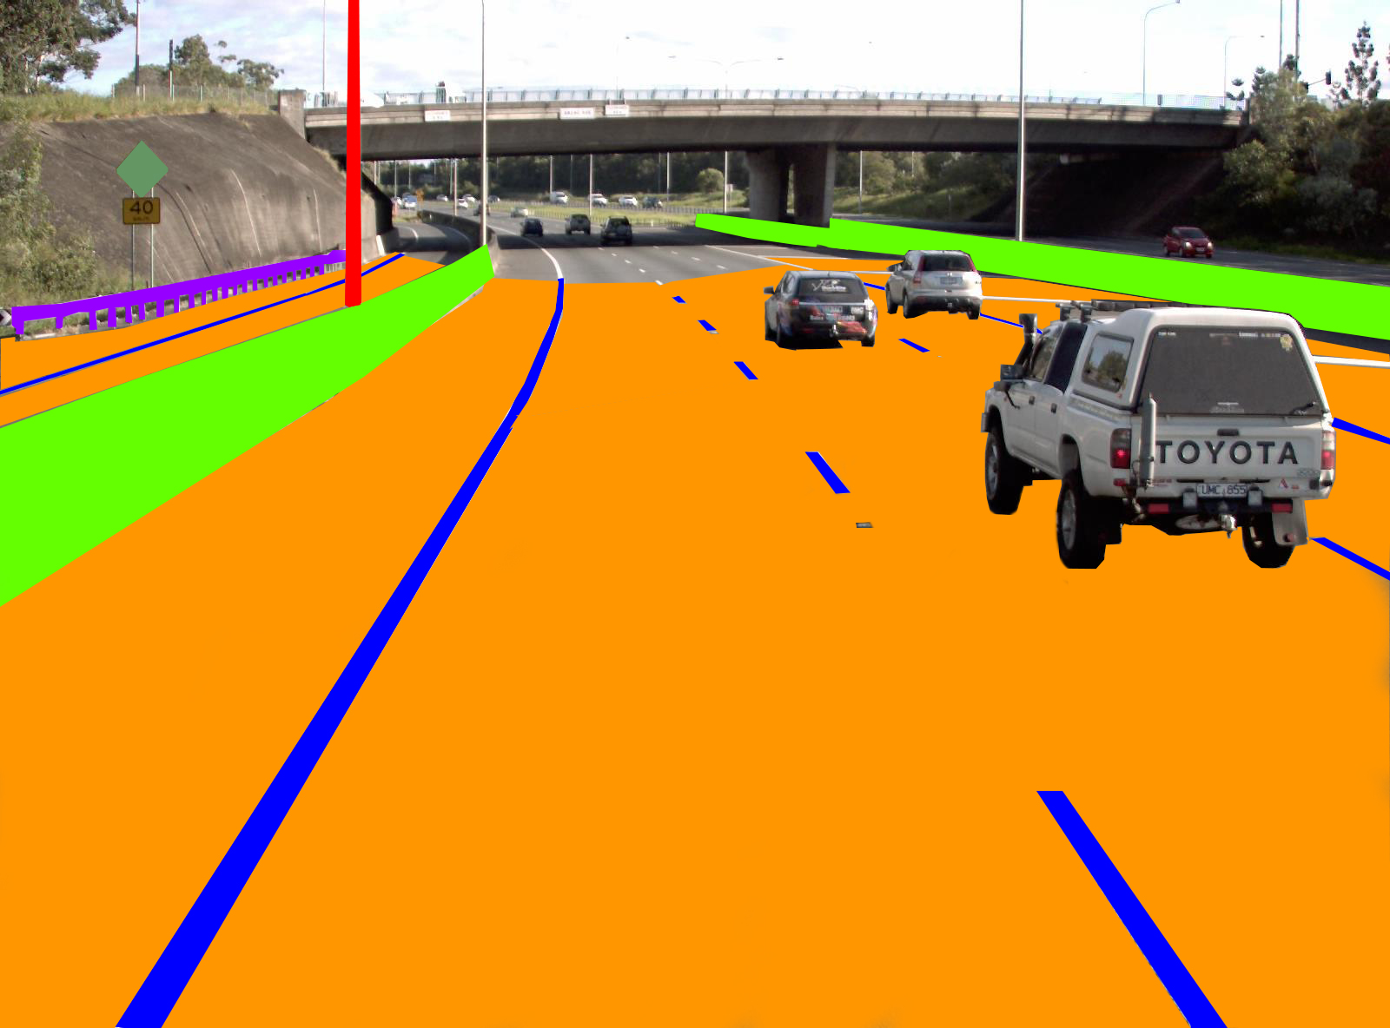
Data Collection
Video Data from ARRB and DTMR, Queensland
Convert Videos into Frames
Annotation
Pole
Curvature Sign
Concrete Barrier
Road
Lane Line
Original Image
Annotated Image

Slide 4
Data Collection
Example AusRAP attributes
Video data contain four videos (left, right, front, rear) from roads, 10A, 10L, 14A and 210A obtained in 2015, 2016, and 2017.
110, 918 frames have been extracted from all these videos.
Area type, speed limit, median type, rumble strip, roadside severity, paved shoulder, intersection type, lane line, quality of curve, road condition, delineation, street lighting, pedestrian crossing facilities, facilities for bicycles, road work, school zone warning, etc.

Slide 5
Literature Review
Enhanced detection and recognition of road markings based on adaptive region of interest and deep learning was proposed by Minh et al. in 2019.
Traffic light recognition system with high dynamic range imaging and deep learning was proposed by Wang et al. in 2019.
Transferable object-based framework on deep convolutional neural networks for building extraction was proposed by Majd et al. in 2019.
Automatic measurement of the traffic sign with segmentation and recognition was proposed by Khalid et al. in 2019.
An automated road crack detection using deep convolutional neural networks was proposed by Mandal et al. in 2018.

Slide 6
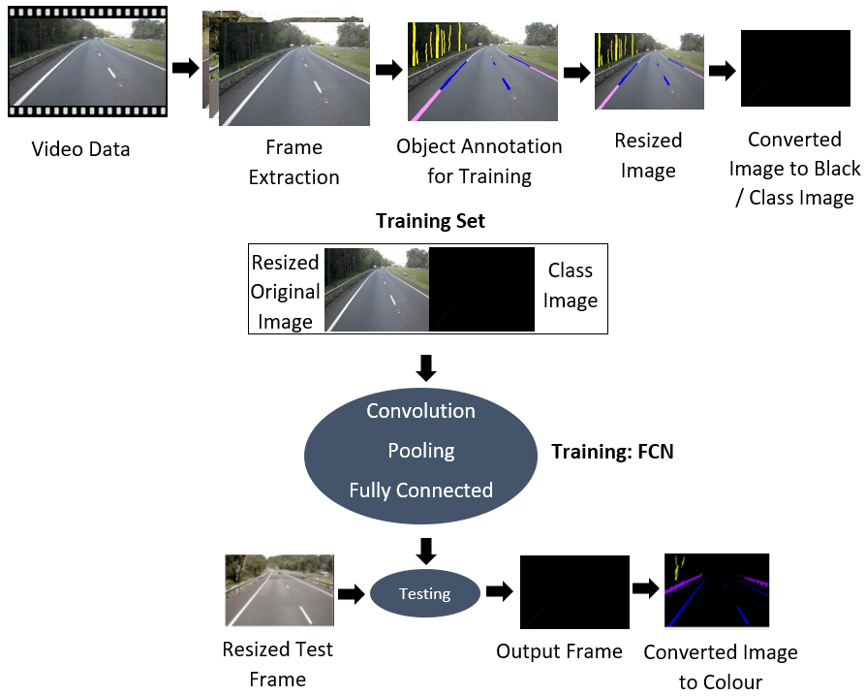
Research Methodology

Slide 7
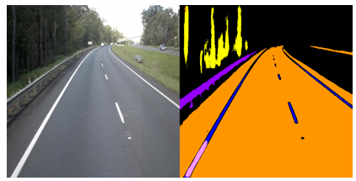
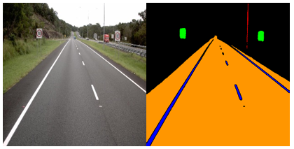
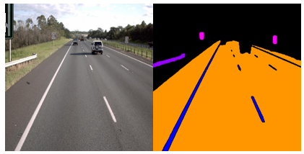
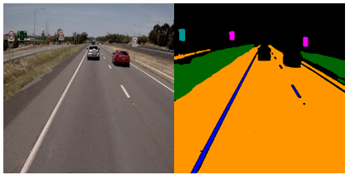
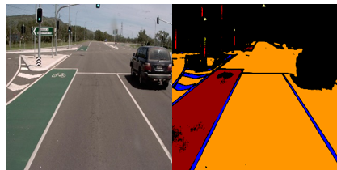
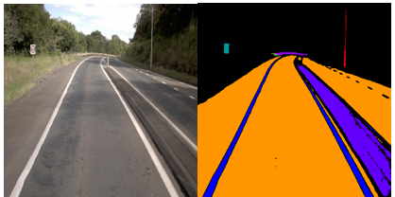
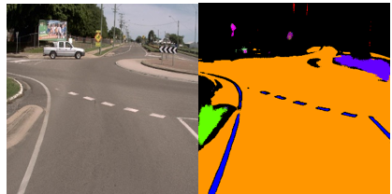
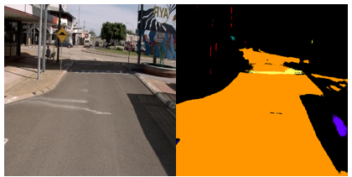
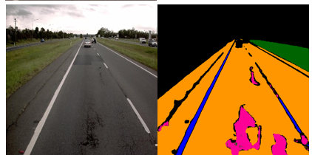
Preliminary Results

Slide 8
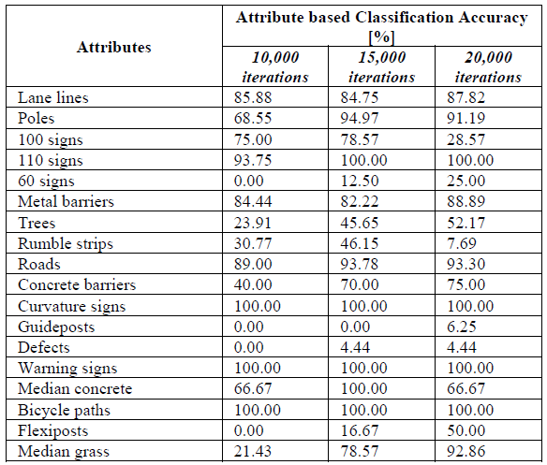
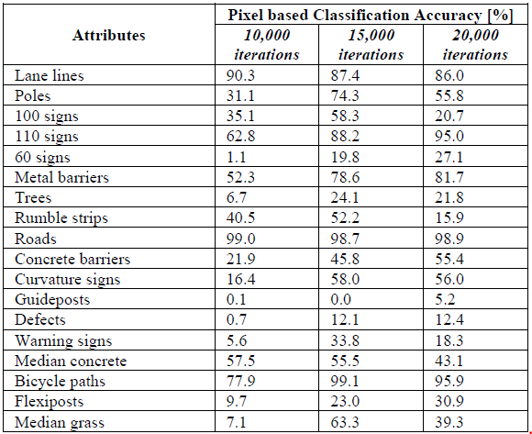
Preliminary Results
Attribute/Object Classification Accuracy for Some Attributes Using 800 × 800 Pixels and 10,000, 15,000, And 20,000 Iterations
Pixel Classification Accuracy for Some Attributes Using 800 × 800 Pixels and 10,000, 15,000, and, 20,000 Iterations

Slide 9
Conclusion
Preliminary results are promising.
Literature review will be extended.
Data will be extended by annotating more videos for training and testing.
Methodology will be extended by adding distance measurement part and optimizing parameters including number of iterations/epochs, input image pixel sizes and filters.

Slide 10


Q & A
Thank You

